Slide 1
Java Memory Mapping
Some of the slides developed by Surtej Sarin

Slide 2
Some Preliminary Concepts:
Two data types, primitive types and reference types.
Primitive type variable
Type is one of: boolean, float, double, byte, short, int, long, or char.
primitive type variable has a primitive value.
stored in the same memory location assigned to the variable, in the stack.
Reference type variable
Type is one of: a class, an interface, or an array
A reference type variable has a reference value.
The reference value is the memory address of the stored object, not the object itself.
stored on the heap
Passing a primitive variable to a method will have no effect on the argument
Passing an object by reference to a method will pass its reference not its value.
So changes made to the reference variable of that object are permanent.
https://docs.oracle.com/javase/specs/jvms/se7/html/jvms-2.html

Slide 3
Memory management
Computer’s operating system performs memory management.
Allocating memory
Deciding the recipient program and amount of memory
Keeping status of memory location (used or free)
“Memory management is the process of allocating new objects and removing unused objects to make space for those new object allocations.” - Oracle
https://docs.oracle.com/cd/E13150_01/jrockit_jvm/jrockit/geninfo/diagnos/garbage_collect.html
Garbage collection is the process of reclaiming unused memory
Creates space for new objects
Removes objects without a reference in the heap.
Java programs themselves take up some space in memory on a computer.

Slide 4
JVM runtime data areas:
Data Areas Shared Among Threads:
Method Area - stores per-class structures such as the run-time constant pool, field and method data, and the code for methods and constructors.
Heap - stores all data objects including both class instances and arrays, except those allocated explicitly in Method Area and Direct Memory area. Objects in heap are allocated when explicitly requested by the application and deallocated by JVM garbage collector automatically.
Direct Memory - stores buffer objects allocated explicitly in direct memory area. Objects in direct memory are also automatically deallocated by JVM garbage collector.
Per-Thread Data Areas:
PC (Program Counter) Register - contains the address of the instruction currently being executed in the thread. If the method currently being executed is native, the value of the PC register is undefined.
JVM Stack - stores a stack of frames. Each frame holds local variables and partial results, and plays a part in method invocation and return of the current running method.
Native Method Stack - stores similar data elements as a JVM stack to execute native (non-Java) methods.

Slide 5
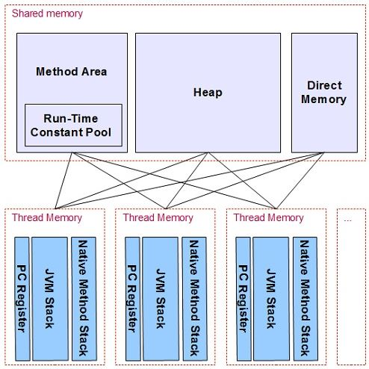
JVM runtime data areas:
http://www.herongyang.com/JVM/Data-Area-What-Are-Runtime-Data-Areas.html

Slide 6
Memory Allocation:
Java has 3 main types of memory in its memory area:
Stack Memory – for pushing in and popping out values. Stack is a last in first out memory - the values entered last comes out first
Heap or Dynamic Memory– for dynamic allocation of storage space during program’s execution. Usually, storage in this area is allocated using the Java keyword ‘new’
Static Memory – for storing static variables. Static variables are common to all class objects. The other type of variable is Java Instance variable, which is object specific

Slide 7
Memory Allocation:
Java call stack:
◦ Each time a Java method is called an entry in the
call stack is added
◦The call stack entry is called a frame
◦A frame may contain local variables, parameters and
other data
◦Frames are also referred to as the Activation Record
Stack

Slide 8
Memory Allocation-4
Stack Trace Example
public static void first(int a) {
int b = a * 2;
int p = 7;
second(b, p);
}
public static void second(int c, int e) {
int d = 5;
System.out.println(c + d + e);
}
public static void main(String[] args) {
int x = 12;
first(x);
}
d
5
Frame
Frame
e
7
c
24
p
7
b
24
a
12
Frame
x
12
args
null

Slide 9
Memory address
The memory address is where an object is stored in memory.
Every byte in the primary memory of a computer has an address.
Suppose that we want to compare two objects. If we were to use the == operator and print the object, we would end up with a symbol that looks like this: A@190dll, which is the name of the object and its System.identityHashCode(). This represents the initial memory address of the object.
There is no way to determine the current memory address of the object because the JVM can relocate the object.

Slide 10
References to objects
A reference to an object is the address of the object’s memory location.
For example:
String b = new String(“abc”);
The heap allocates memory for the new String object.
Suppose this object is stored in the memory address 1010.
Here is what it would look like memory:
Stack
Heap
1010
1010
abc
p

Slide 11
Method calls
When a method is called, it requires memory to store information.
A call stack is the memory allocated to hold a return address and the local variables.
A stack frame is storage on the call stack that is generated at when a method is called.
A call sequence describes the process of calling a method

Slide 12
The steps of a call sequence
Argument lists are evaluated from left-to-right
An expression must be evaluated before the call is made and this excludes variable or literals.
A new stack frame is pushed on the call stack
A parameter and local variable is stored and is reserved in the stack frame.
Method returns are saved automatically.
Parameters are initialized
Evaluated arguments are assigned to local parameters in the called method.
Method execution
Once the stack frame has been initialized the method starts to execute.
A method may make a call to another method. If so, this will push and pop its stack frames on the call stack.
Method return
This happens when the method is completed or a return statement is encountered.
Methods that are not void return a value, which is passed back to the calling method.
The stack frame storage for the called method is then “popped” off the call stack. In other words, a pointer is moved to the previous stack frame and now the current stack frame can be called by other methods.
The calling method continues to execute from the spot where the method was called.
http://www.fredosaurus.com/JavaBasics/methods/methods-25-calls.html

Slide 13
Array allocation
In Java, an array stores either a primitive value or a reference to an object.
Arrays are treated the same way in memory as objects.
When an array is declared, it is not assigned a memory address. The array reference is automatically assigned the value null, meaning that the identifier is not associated with a memory address. It is important to note, an array does not explicitly need to be assigned null.
int [ ] arr;
int [ ] arr = null;
When an array is defined using the keyword new, memory is allocated on the heap and the array reference obtains a memory address.
int [ ] arr = new int [20];
In the example above, arr has a memory address, however, since it is uninitialized, each element of arr has the value of 0, because it is an integer array. Similarly, the default value of a double would be the 0.0, boolean would be false, char would be the null code point '\u0000‘, and String would be null.
Providing values for elements in an array is also known as populating the array.
int [ ] arr = {1, 2, 3, 4, 5};
http://www.programcreek.com/2013/04/what-does-a-java-array-look-like-in-memory/
Java Programming. Farrell, J. 9781305480537. https://books.google.com/books?id=bzp-BAAAQBAJ. 2015, Cengage Learning. Pages: 400-401.

Slide 14
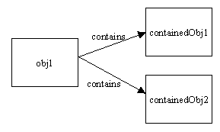
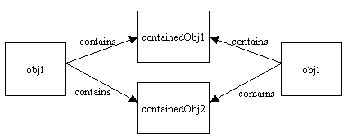
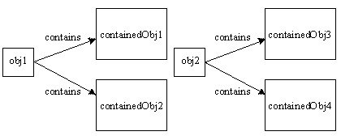
Copying an object in memory
There are two main ways to copy an object in memory: shallow and deep copy.
Image 1 is an object that contains two objects.
Image 2 is the shallow copy of image 1.
Image 3 is the deep copy of image 2.
http://stackoverflow.com/questions/869033/how-do-i-copy-an-object-in-java
For the following examples, suppose an array of Dog objects, called puppies is passed as an argument to the method from the main in a class called Pound, i.e., private Dog[] puppies = new Dog [5];
Image1: http://i.stack.imgur.com/ZK4pQ.gif
Image2: http://i.stack.imgur.com/xhF9B.gif
Image3: http://i.stack.imgur.com/mtNjt.gif

Slide 15
Reference copy
Reference copy - where the reference to the original object is returned.
It is technically not considered a copy
public class Pound {
…
public Dog[] referenceCopy (Dog[] puppies) {
return puppies;
}
}
Stack
Heap
puppies

Slide 16
Shallow copy
Shallow copy - where a new object is created that points to the same reference address of the original object.
public class Pound {
…
public Dog[] shallowCopy(Dog[] puppies) {
Dog[] copy = new Dog[puppies.length];
for (int i = 0; i < copy.length; i++)
{
copy[i] = puppies[i];
}
return copy;
}
}
Stack
Heap
copy
puppies

Slide 17
Deep copy
Deep copy - where a new object is created (from the original object) and it points to a different reference address. Must use the keyword “new”.
public class Pound {
…
public Dog[] deepCopy(Dog[] puppies) {
Dog[] copy = new Dog[puppies.length];
for (int i = 0; i < copy.length; i++) {
copy[i] = new Dog(puppies[i]);
}
return copy;
}
}
Stack
Heap
copy
puppies

Slide 18
Memory Maps-1
Memory Maps
Used to represent the state of the call stack and Java dynamic memory (heap)
Following illustrates how to draw Java Memory Map
Consider the Java Program in the next slide. It has two different classes.
class SimpleClass contains two Java Instance Methods
class ClassVsObjectMethods contains two Java Class Methods
Codes inside public static void main of MemoryMap class makes use of the above two classes
For simplicity, we draw the Memory Map for only the code inside public static void main

Slide 19
Memory Maps-2
class SimpleClass{
private int x;
SimpleClass(int a) { x = a;}
public int reportState() { return x; }
public void increaseState{ ++x;}}
class ClassVsObjectMethods {
static void A() { System.out.println(“Class Method 1”);}
static void B() { System.out.println(“Class Method 2”);}}
class MemoryMap{ public static void main(String args[]) {
SimpleClass Obj1 = new SimpleClass(0);
SimpleClass Obj2 = new SimpleClass(0);
Obj1.increaseState();
Obj1.increaseState();
Obj2.increaseState();
ClassVsObjectMethods.A();
ClassVsObjectMethods.B();
ClassVsObjectMethods x;
Double pi = 3.14; }}
Following slide shows the Java Memory Map for code inside void main( )

Slide 20
Memory Maps-3
Java Memory
SimpleClass: object
SimpleClass: class
Obj1
x
2
SimpleClass: references
Obj2
reportState()
increaseState()
ClassVsObjectMethods : class
double
SimpleClass: object
pi
3.14
x
1
ClassVsObjectMethods:
reference
reportState()
A()
increaseState()
B()
x

Slide 21
Memory Maps-4
How Call Stack Works:
The call stack makes it possible to:
Create and destroy local variables easily
Create local variables when frame is created and pushed on stack
Destroy local variables when frame is removed from stack
Stack is Last-In-First-Out (LIFO)
The order in which methods are called is very important: it is how frames will be stored onn the Stack
If A calls B and B calls C, then C’s frame must be removed before B’s, and B’s before A’s
As a result of this Frame concept, we may use the same name for local variables in different methods
Each frame “hides” its own local variables from other frames

Slide 22
Memory Map Examples:
Draw the memory map of the following int and of the one-dimensional array of type int.
int[] a = new int[6];
int b = 1234;
Stack
Heap
0
0
0
0
0
0
b 1234
a

Slide 23
2. Draw the memory map of the following one-dimensional array of String.
String[] z = new String[3];
for (int i=0; i<z.length; i++) {
z[i] = “number ” + i;
}
Stack
Heap
“number 0”
“number 1”
“number 2”
z

Slide 24
3. Write a shallow copy of the following and draw the memory map. Assume there are objects defined as Student s1, s2, s3, s4, s5;
Student[] students = {s1, s2, s3, s4, s5};
Student[] copy = new Student[students.length];
for (int i=0; i<copy.length; i++) {
copy[i] = students[i];
}
Stack
Heap
s1
s2
s3
copy
s4
s5
students

Slide 25
4. Write a deep copy of the following and draw the memory map:
Assume there are objects defined as Student s1, s2, s3, s4, s5; and that Student has a copy constructor
Student[] students = {s1, s2, s3, s4, s5};
Student[] copy = new Student[students.length];
for (int i=0; i<copy.length; i++) {
copy[i] = new Student(students[i]);
Stack
Heap
s1
s2
s3
s4
s5
s1
s2
copy
s3
s4
students
s5

